Slide 1
Empirical analysis of impacts of normalization, distance and agglomeration methods on hierarchal clustering of breast cancer data.
Xuan Zhou

Slide 2
Data
Collins FS, Barker AD. Mapping the cancer genome. Pinpointing the genes involved in cancer will help chart a new course across the complex landscape of human malignancies. Sci Am. 2007 Mar;296(3):50-7.
http://eh3.uc.edu/GenomicsPortals
Query: differential expression.
Only genes in PAM50 list were selected.
Sample labeling was based on PAM50Call.
* PAM50: Parker JS, Mullins M, Cheang MC, Leung S, Voduc D, Vickery T, Davies S, Fauron C, He X, Hu Z. et al. Supervised risk predictor of breast cancer based on intrinsic subtypes. J Clin Oncol. 2009;27(8):1160–1167. doi: 10.1200/JCO.2008.18.1370

Slide 3
Data
50 (genes)* 919(tissue samples) matrix
Genes were selected from PAM50 list.
Samples include 4 types of breast cancer tissues and normal controls . There are also samples whose types can not been determined by PAM50call.

Slide 4
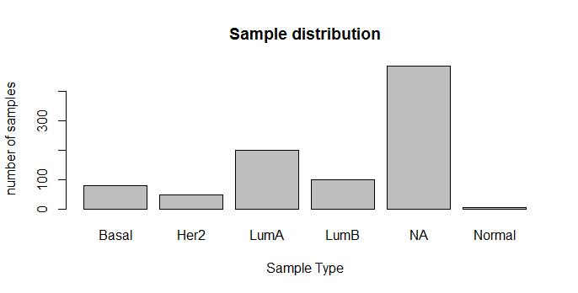

Slide 5
Normalization
Original data was not normalized or centered.
Two normalization approaches were used per gene:
zeroOneScaling :
function(vec) { minVec = min(vec);
maxVec = max(vec);
(vec - minVec)/ (maxVec - minVec); }
zscoreScaling :
function(vec) { sdVec = sd(vec);
meanVec = mean(vec);
(vec - meanVec) / sdVec; }

Slide 6
Distance and agglomeration functions
Only functions implemented in R were used.
Distance functions : "euclidean", "maximum", "manhattan", "binary", "minkowski", "canberra";
Agglomeration functions: "ward“(wa), "single“(si), "complete“(co), "average“(av), "mcquitty“(mc), "median“(me), "centroid“ (ce).

Slide 7
Evaluation
Truth: clustering result from PAM50call (generated by GenomicsPortals).
Our clustering result: 1. normalization; 2. calculate distances between samples using the R function dist(matrix, fun), where fun is one of the distance functions listed in previous slide; 3. build the hierarchical tree use the R function hclust(dist, fun), and here fun is one of the agglomeration functions mentioned. 4. cuttree in to desired number of groups.
Evaluation of clustering was performed using Rrand(vec1, vec2) function from the “phyclust” package, which calculated the rand index.
Code: https://github.com/reformasky/R_script

Slide 8
Results - zeroOneScaling

Slide 9
Results - zscoreScaling

Slide 10
Conclusions
1. Normalization method matters: overall speaking, zscoreScaling outperforms zeroOneScaling.
2. Of all the distances functions, euclidian, manhattan, maximum and minkowski generally give rise to reasonable outcome.
3. Of all the clustering fuctions, ward consistently produces best outcome, complete and mcquitty also generate acceptable clustering.

Slide 11
Distance functions
euclidean:Usual distance between the two vectors (2 norm aka L_2)
maximum:Maximum distance between two components of x and y (supremum norm)
manhattan: Absolute distance between the two vectors (1 norm aka L_1).
canberra: sum(|x_i - y_i| / |x_i + y_i|).
binary:(aka asymmetric binary): The vectors are regarded as binary bits, so non-zero elements are ‘on’ and zero elements are ‘off’. The distance is the proportion of bits in which only one is on amongst those in which at least one is on.
minkowski: The p norm, the pth root of the sum of the pth powers of the differences of the components.

